Slide 1
Happy New Year
Welcome to the Central Presentation
Surgery Unit- I,
under Prof. A B M Khurshid Alam

Slide 2
A 42-year-old Male with Frequent Episodes of Transient Loss of Consciousness with Confusion
Dr. Sarkar Kamrun Jahan Jhinuk
Assistant Registrar
Surgery Unit-I
Dhaka Medical College Hospital

Slide 3
Particulars of patient
Name : Mr. Nasir Ali Khan
Age : 42 yrs
Sex : Male
Religion : Islam
Occupation : Soldier of BGB
Marital status : Married
Present address : Peelkhana, Dhaka
Permanent address : Gopalgonj, Dhaka
Date of admission : 28.05.19

Slide 4
Chief complaints:
Recurrent loss of consciousness and confusion for 3 years
Gradual weight gain for same duration

Slide 5
History of present illness
According to the statement of the patient, he was reasonably well 3 years back. Then one day suddenly he lost his consciousness before lunch which lasted for a short period, associated with sweating without any tongue bite and urinary incontinence. He recovered by i/v fluid given by a local quack. Over last 3 years he suffered from similar type of attacks repeatedly about 3-4 times per week which were precipitated by empty stomach.

Slide 6
History of present illness: cont……
Regarding the Confusion, his family members stated that, before each attack of unconsciousness, he became confused with irrelevant speech and incoherent talks. Otherwise he remains normal in behaviour and talking. The family members became habituated to give sugar water or juice during the confusional state to prevent such attack.

Slide 7
History of present illness: cont….
He also complained of weight gain about 10 kg over last 3 years inspite of his normal appetite. He was admitted and treated conservatively in another hospital in 2017 for similar type of problem. He is a known case of hypothyroidism on Thyroxin.

Slide 8
History of present illness: cont….
There is no history of convulsion, headache, blurred vision, vomiting, palpitation, chest pain and skin changes. He has no abdominal pain, no bone pain, no H/O Jaundice. He is normotensive, non-diabetic and non-asthmatic.
Initially, he was admitted at DMCH in another department and seek our consultation. Subsequently, he was transferred to surgery unit-I.

Slide 9
History of past illness No significant surgical past history. Personal history He is a non-smoker and non-alcoholic. Family history There is no positive family history of similar illness. All his family members are healthy and well.

Slide 10
Socio-economic history He comes from a middle class family, uses sanitary latrine & drinks tube-well water. Treatment history He takes Tab. Thyrox (50 mg) twice daily. He occasionally took herbal medications. History of allergy He has no known allergies. Immunization history: He was immunized as per EPI schedule.

Slide 11
Examination: General examination
Appearance : Normal
Body built :Average
Decubitus : On choice
Nutrition : Sufficient
Anaemia : Absent
Jaundice : Absent
Cyanosis : Absent
Oedema : Absent
Clubbing : Absent
Koilonychia : Absent
Pigmentation : Normal

Slide 12
General examination: cont….
Body hair distribution : Normal
Neck vein : Not engorged
Dehydration : Absent
Accessible Lymph node: Not enlarged
Thyroid gland : not palpable
Pulse : 72 bpm
Blood pressure : 130/70 mmHg
Respiration : 18 b/min
Temperature : 980 F
JVP : Not raised
BMI : 29 (ht- 5.8 ft, wt- 190 lb)

Slide 13
Systemic Examination:
Alimentary system:
Mouth and throat: Normal
Abdomen proper examination:
Inspection:
Shape : Normal
Umbilicus : Normal, inverted
Skin : Normal
Scar mark : Absent
Visible peristalsis : Absent
Hernial orifices : Normal and cough reflex absent
External genitalia : Normal

Slide 14
Systemic Examination:
Alimentary system: cont….
Palpation
Superficial : Non- tender, muscle gird and rigidiy- absent. : No palpable lump
Deep : Any palpable lump- absent
: No organomegaly
Percussion
:Upper border of liver dullness: Right 5th intercostal space
:Fluid thrill and shifting dullness- absent.
Auscultation:
Bowel sound : Present and normal.

Slide 15
Systemic Examination:
Nervous system
Higher psychic function : Normal
Cranial nerves : Intact
Gait : Normal
Sensory function : Intact
Signs of meningeal irritation : Absent
Reflexes : Normal

Slide 16
Systemic Examination:
Cardiovascular system
Pulse : 72 beats/min, regular, symmetrical, normal volume, normal condition of the vessel wall
BP :130/70 mmHg. No postural hypotension.
Neck vein: Not engorged, Carotid pulse: Normal
Precordium Examination:
Inspection:
Shape : Normal
Apical impulse : Absent
Parasternal pulsation : Absent
Supra-sternal pulsation : Absent
Scar mark : Absent

Slide 17
Systemic Examination:
Cardiovascular system: cont….
Palpation:
Apex beat : At the 5th intercostal space
Thrill : Absent
Parasternal heave : Absent
Epigastric pulsation : Absent
Auscultation:
Heart sound : 1st and 2nd heart sounds are audible
Added sound : Absent
Murmur : Absent

Slide 18
Examination of Thyroid
Thyroid gland: Not enlarged
Cervical Lymph nodes: not enlarged
Eye sign : absent
Tremor: Absent
Pulse: Normal
Reflexes: Normal
Other systemic examinations: No abnormality.

Slide 19
Salient Features:
Mr. Nasir Ali khan,42-year-old, normotensive, nondiabetic, nonsmoker, nonalcoholic, hypothyroid, BGB soldier, presented with Recurrent loss of consciousness and confusion & gradual weight gain for 3 years. He was reasonably well 3 years back. Then one day suddenly he lost his consciousness before lunch which lasted for a short period, associated with sweating without any tongue bite and urinary incontinence. He recovered by i/v fluid given by a local quack.

Slide 20
Salient Features: cont….
Over last 3 years he suffered from similar type of attacks repeatedly about 3-4 times per week which were precipitated by empty stomach. Regarding the Confusion, each attack was preceded by confusion with irrelevant speech and incoherent talks. Otherwise he remains normal in behaviour and talking. He was habituated to take frequent meal to prevent such attack. He also complained of weight gain about 10 kg over last 3 years inspite of his normal appetite.

Slide 21
Salient Features: cont…
There is no history of convulsion, headache, blurred vision, vomiting, palpitation, chest pain and skin changes. He has no abdominal pain, no bone pain, no H/O Jaundice. He is normotensive, non-diabetic and non-asthmatic.
Initially, he was admitted at DMCH in another department and seek our consultation. Subsequently, he was transferred to surgery unit-I.

Slide 22
Salient Features: cont…
On examination, he was not anaemic, non-icteric and non-cyanosed. His pulse was 72 bpm, BP 130/70 mmHg, respiratory rate 18 b/min. No postural hypotension. Other findings were normal.
All systemic examinations revealed no abnormality.

Slide 23
Provisional Diagnosis……..
?

Slide 24
Provisional Diagnosis……..
Hypothyroidism with Hypoglycemia due to (?)

Slide 25
Differential Diagnosis:
Hypothyroidism with unknown Sarcoma (paraneoplastic syndrome)
Hypothyroidism with Insulinoma
Hypothyroidism with Adrenocortical failure

Slide 26
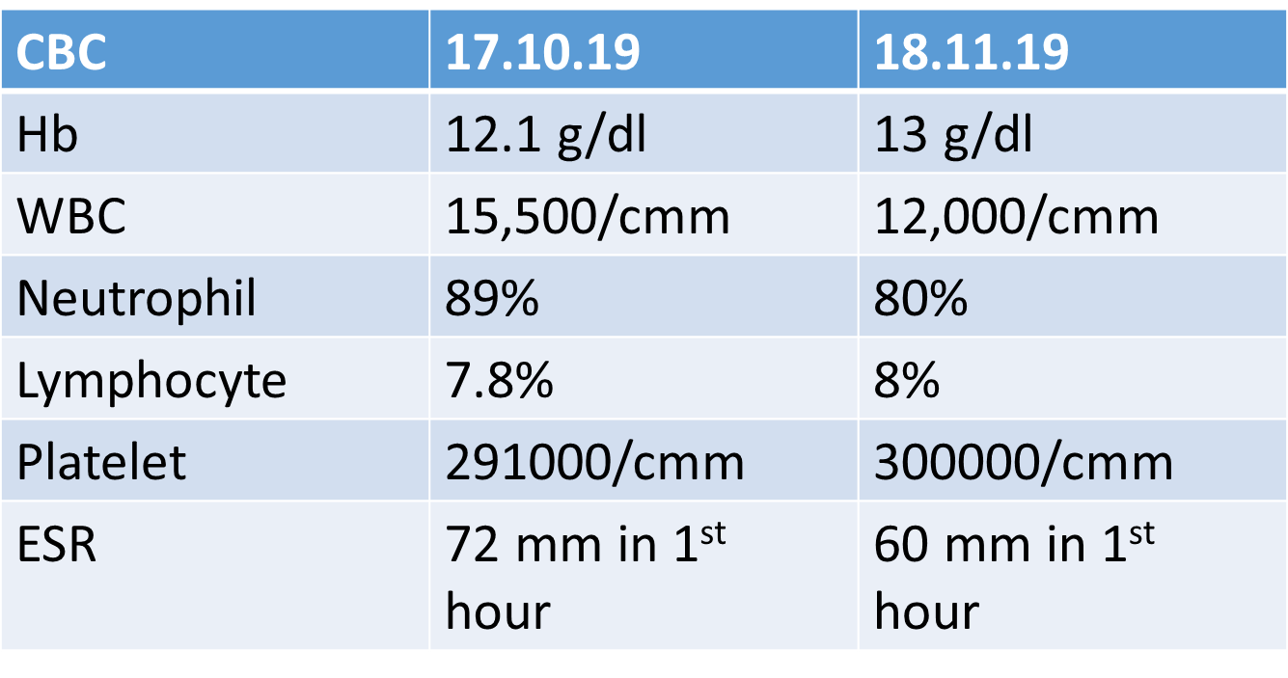
Investigations:

Slide 27
Serum Electrolytes;
Investigations:
 | mmol/l
Na | 145
K | 4.51
Cl | 105
Ca | 9.0 mg/dL
 | 21.08.19 | 17.10.19
S.Creatinine | 1.07 mg/dl | 1.31 mg/dl
S.Albumin | 3.50 g/l | 3.31 g/l

Slide 28
Investigations: Cont….
 | 11.08.19 | 01.10.19
Fasting blood sugar | 5.0 mmol/L | 2.4 mmol/L
2 hr after breakfast | 7.0 mmol/L | 6.5 mmol/L
HbA1C | 6% | 5.5%

Slide 29
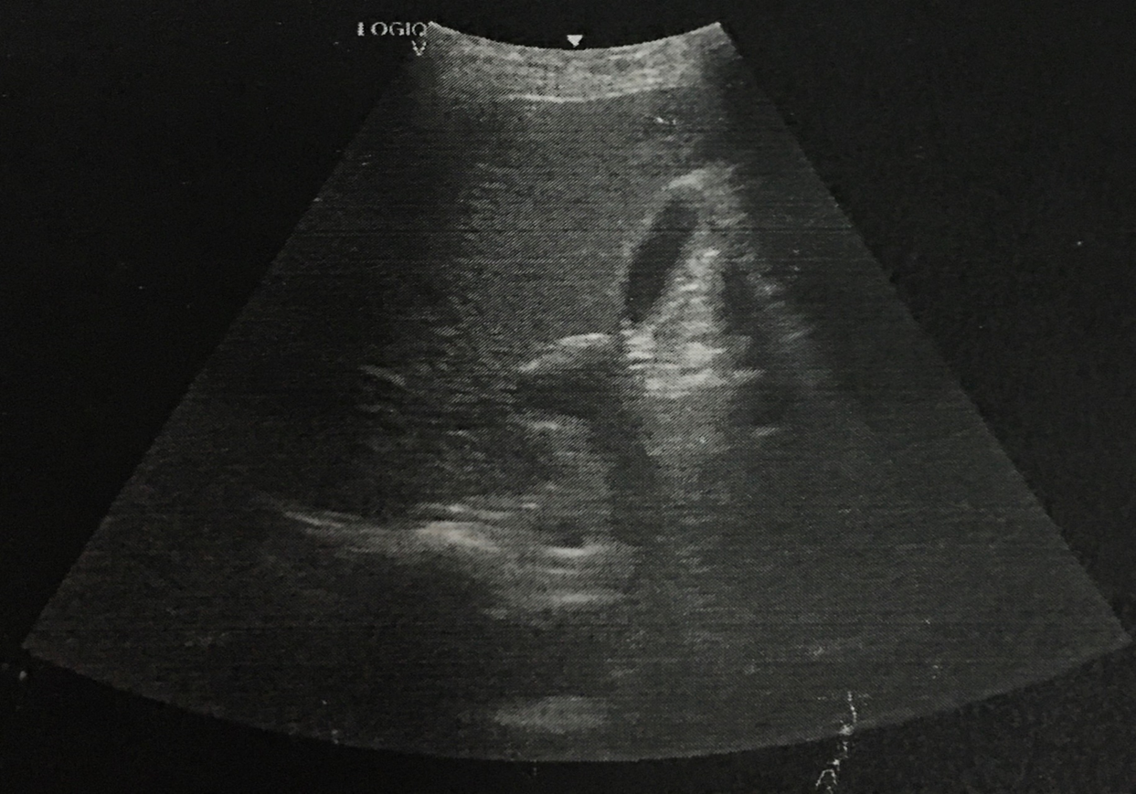
Investigations: Cont….
USG of whole abdomen (21.07.19)
Impression:
Normal study on USG of whole abdomen

Slide 30
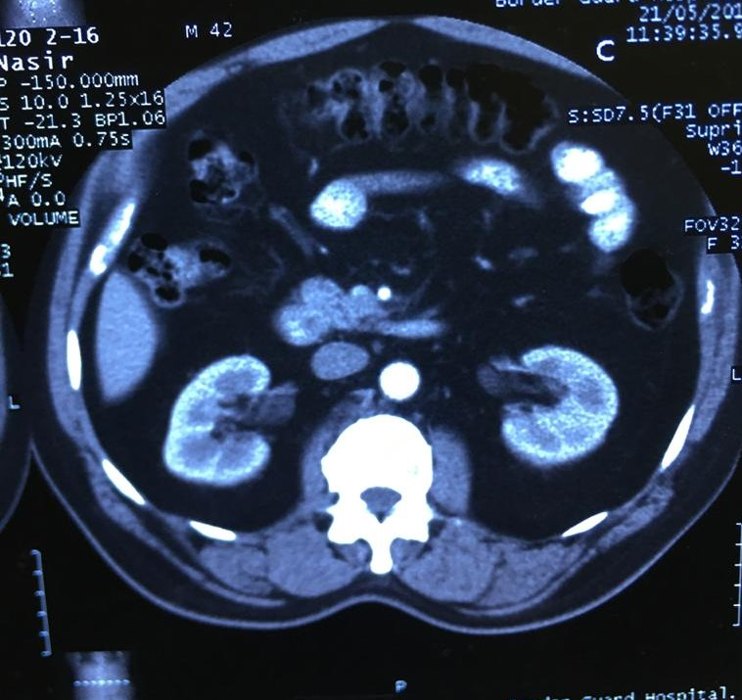
Investigations: Cont….
CT scan of whole abdomen (21.5.19)
Impression:
No abnormality detected

Slide 31
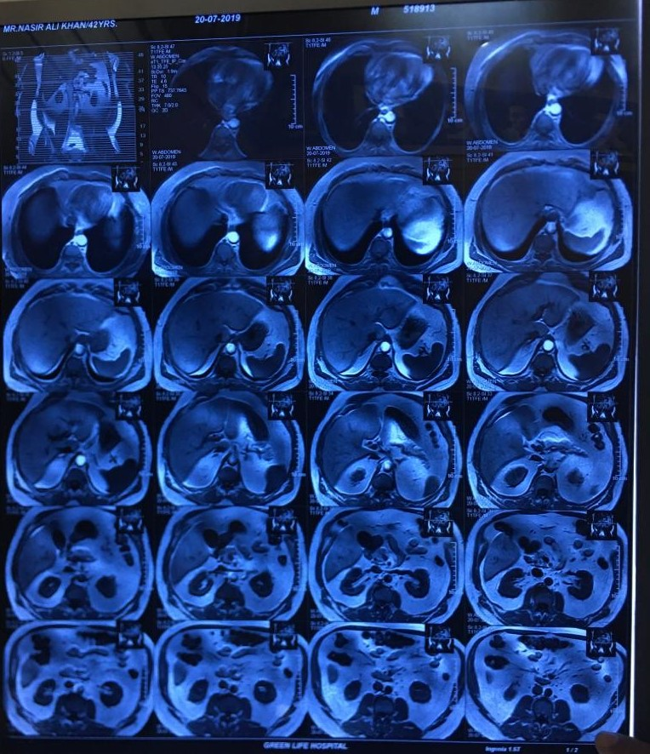
Investigations: Cont….
MRI of whole abdomen ( contrast) on 20.7.19

Slide 32
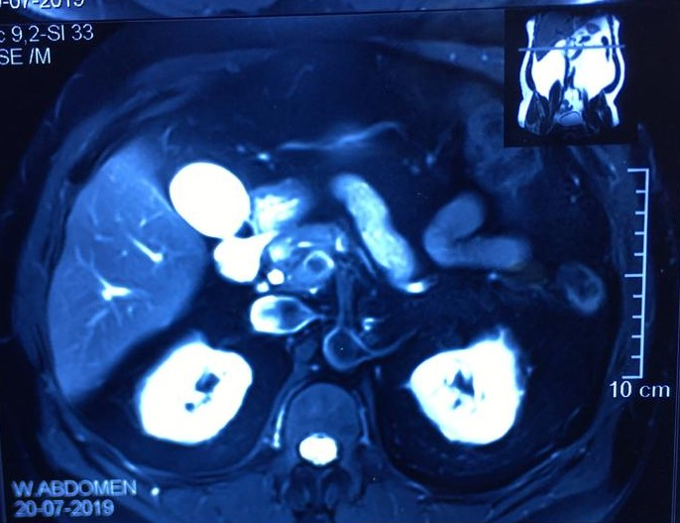
Investigations: Cont….
MRI of whole abdomen ( contrast) on 20.7.19
Comment:
Small SOL in the upper part of the head of the pancreas (measuring 16.5x 12.7x 10.3 mm)

Slide 33
Investigations: cont….
 | Result | Ref.Value
FT3 | 2.81 p mol/L | 3.5-6.5 p mol/L
FT4 | 14.80 p mol/L | 11.55-22.7 p mol/L
TSH | 0.14 uIU/mL | 0.35-5.5 micro IU/mL
 | 01.6.19 | 10.10.19 | Ref.Value
C-Peptide | 6.12 ng/ml | 5.98 ng/mL | 0.78-5.19
S.Insulin | 90.88 uIU/mL (Ref. 3-27 Uiu/mL ) | 15.30 mU/L | Fasting <25 mIU/L 2 hrs after glucose intake:16-166 mIU/L

Slide 34
Investigations: cont….
72 hours supervised fasting test:
Develops symptomatic hypoglycemia within 4 hrs. Then blood samples were taken & patient was given i/v glucose.
Insulin to Glucose Ratio during fasting (>0.3 indicates Insulinoma)
Blood Insulin level = 15.50 uIU = 6.3
Blood Glucose 2.4 mmol/L

Slide 35
Investigations : cont…
Coagulation profile:
APTT - 28.0 seconds
Factor-VIII – 206% (Ref. 50-150%)
Factor-IX - 138% (Ref. 70-120%)
Others test (19.10.19)
Basal cortisol (9am)- 35.09 nmol/l (Ref. 101.2-690.o nmol/l)
Procalcitonin-0.09 ng/ml (Ref. <0.25 ng/ml)

Slide 36
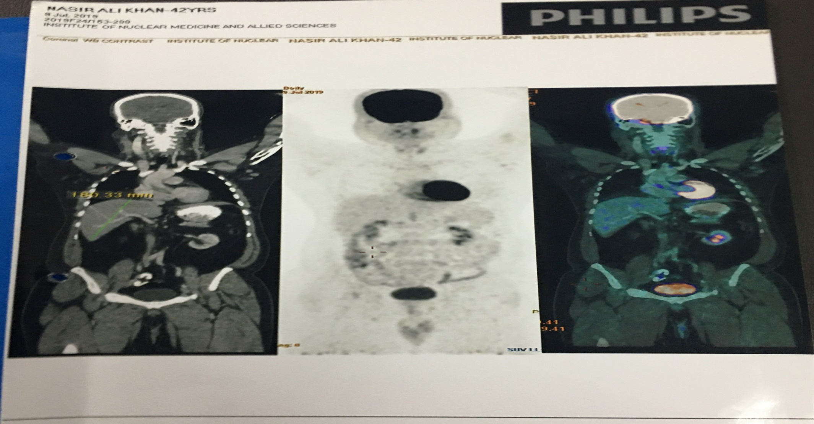
Investigations: Cont….
Whole body 18F-FDG PET-CT scan (17.07.19)

Slide 37
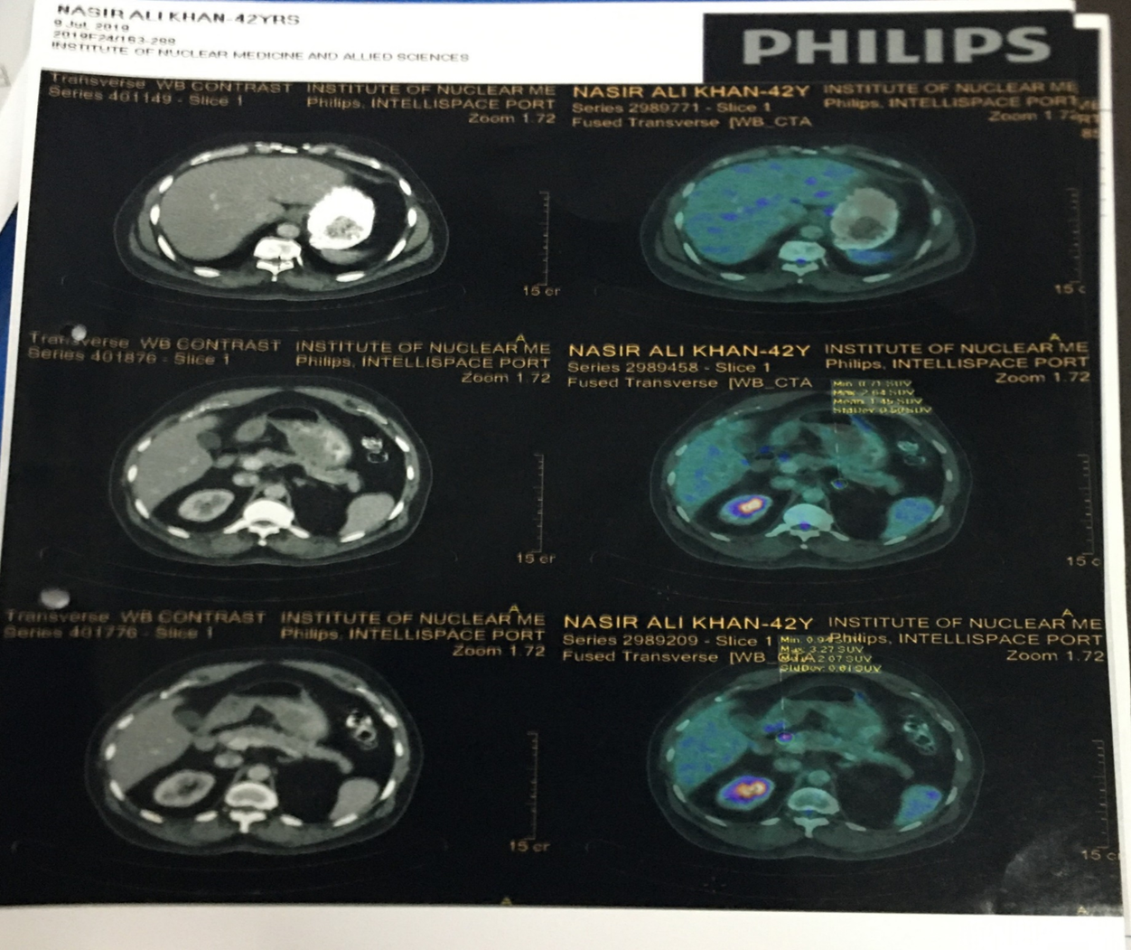
Investigations: Cont….
Whole body 18F-FDG PET-CT scan (17.07.19): cont….
Comment:
No focal abnormal uptake of FDG anywhere.
Comment:
No foe of FDG anywhere else.

Slide 38
Confirmatory Diagnosis……..
Hypothyroidism with Insulinoma (Head of the pancreas)

Slide 39
Whipple’s Triad: Classic diagnostic criteria ( in 1935, Whipple & Franz after revewing 35 cases of insulinoma, inunciated primary diagnostic criteria)
Hypoglycemic symptoms produced by fasting
Blood glucose below 50 mg/dL (2.7 mmol/L) during symptomatic episodes
Relief of symptoms by intravenous administration of glucose.

Slide 40
American Endocrine Society Guideline
“Blood glucose level < 2.5mmol/L, but Insulin level >6 uIU, Diagnostic of “Spontaneous Hypoglycaemia due to Insulinoma”

Slide 41
Management Plan:
Regarding the management, a medical board consisting of faculty of department of Surgery, dept. of Endocrinology, dept. of Radiology & imaging & dept of Anesthesiology held on 29.09.19 at 08:00 am.
Decision of the medical board:
Enucleation after per-operative USG localization
Counselling and consent for Whipple’s operation

Slide 42
Management Plan:
Preparation the Patient for operation:
-Glycemic control was continued.
-Informed the respective departments
Department of anaesthesia
Department of endocrinology
Department of radiology & imaging
Based upon medical board decision an operation was done on 07.10.19 at (9.45-11.00) am

Slide 43
Operation Note:
Date : 07.10.19
Time : (9.45-11.00) am
Name of operation : Enucleation of tumour (Head of Pancreas)
Anaesthesia : G/A
Procedure & Findings
: Under G/A abdomen was explored by a right upper oblique incision. There was no ascites, liver metastasis and peritoneal seedling.
.

Slide 44
Lesser sac was approached through gastrocolic ligament. After kocherization of the duodenum, tumour was identified in the head region of pancreas which was macroscopically pale, elevated. On tactile sensation, firm in consistency, different from the rest of the pancreatic tissue.

Slide 45
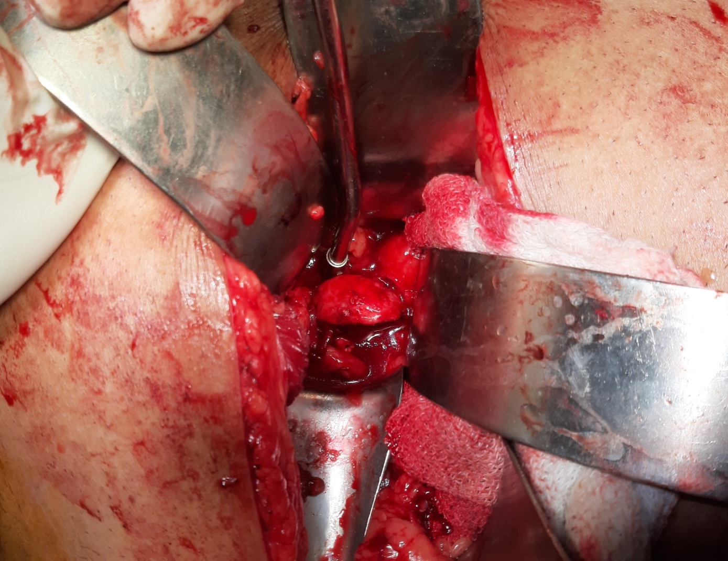
During dissection & eneucleation of the tumour, profuse bleeding was secured (by pressure, packing diathermy & ligation of the vessels.
2 drain tubes were kept in situ. Abdomen was closed by layers. Specimen was sent for histopathology.

Slide 46
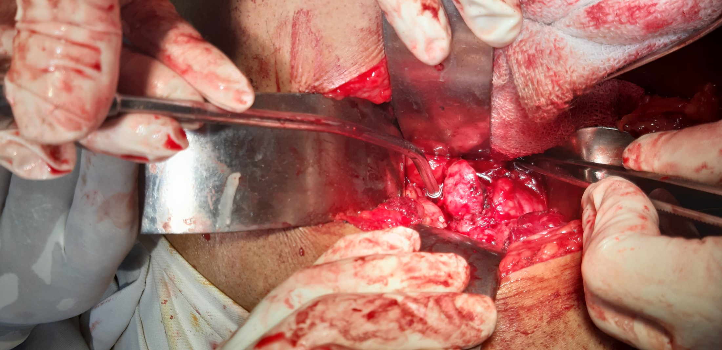

Slide 47
Operative Challenges
Peroperative Localization: Identification of the lesion was done by inspection, tactile perception by the surgeon. There was no per-operative USG feasibly available for exact localization.
Difficult haemostasis.

Slide 48
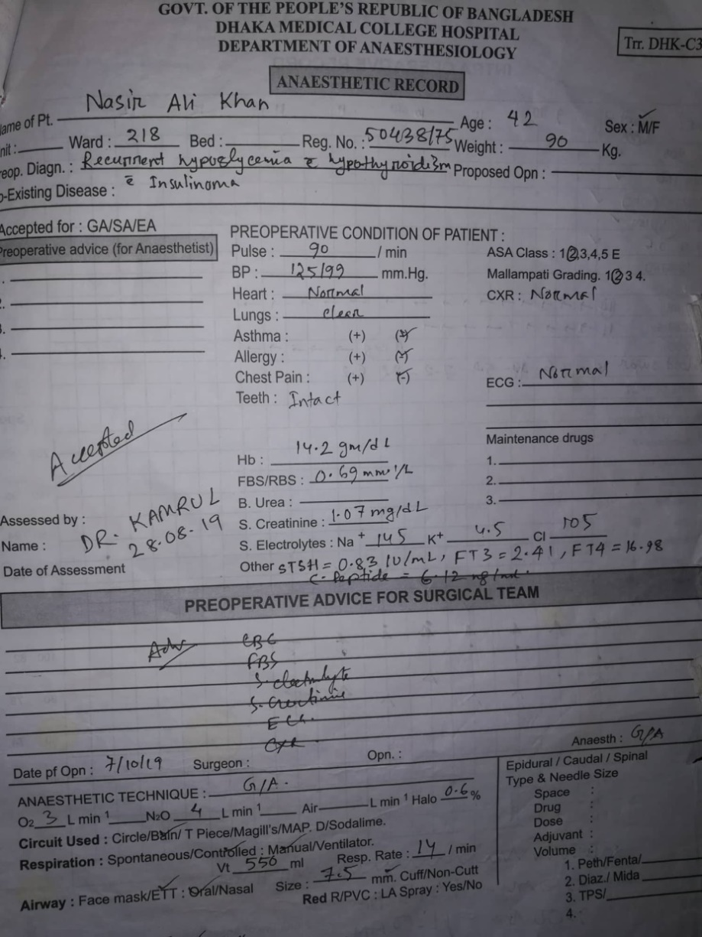
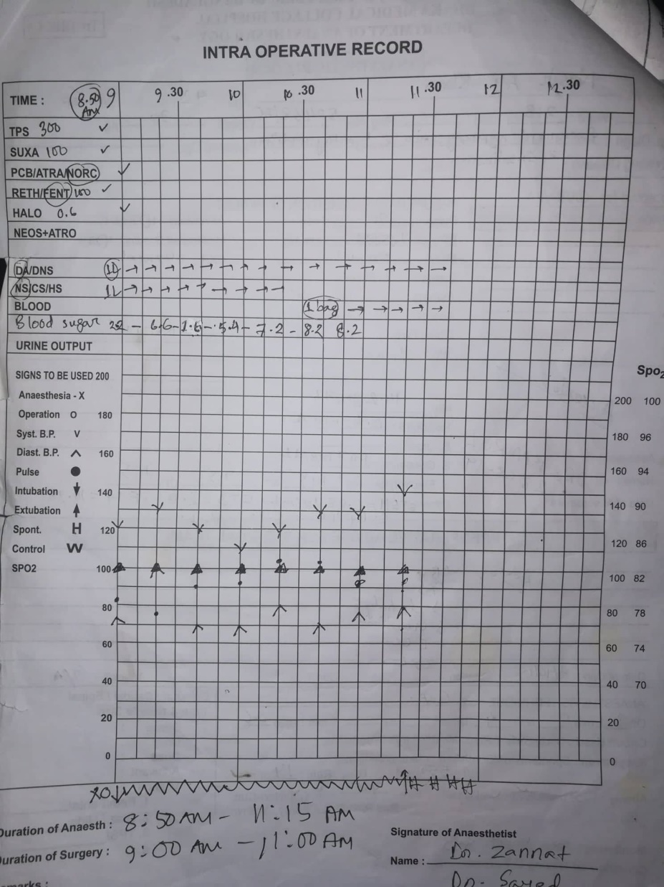
Operative Challenges
Per-operative continuous monitoring of glucose was done. During handling of the lesion, blood sugar level falled dramatically, even upto 1.6 mmol/L. But after ligation of the feeding vessels of the tumour, blood glucose level reverted back to normal eventually.

Slide 49
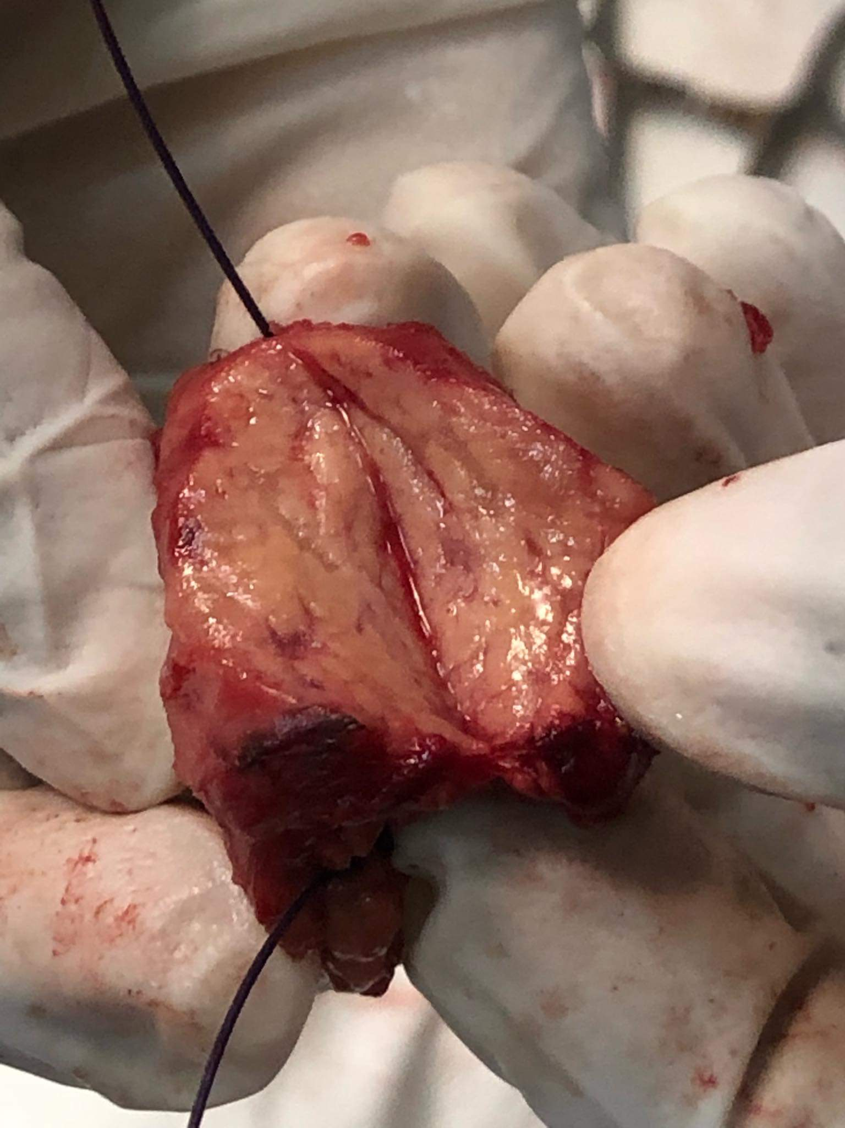

Slide 50
Post- operative Follow- up:
POD |  | Management
1st | Uneventful & blood sugar stable | HDU management as per anesth. dept
2nd | ” | ”
3rd | Sudden respiratory distress along with SPO2 fluctuation & the lowest one was 70%. Blood sugar level was flactuating and maintained within normal limit. | Shifted to ICU Consultation with other departments
4th | Improving | ICU management
5th | Stable | ”

Slide 51
Post- operative Follow- up:
POD |  | Management
10th | Wound infection was noted. | Hence, all stitches were removed and dressing was done daily with appropriate antibiotic coverage
18th | The condition was improved & patient was stable | Shifted to the ward -218 from ICU
30th | In the ward his recovery was good except SSI | Secondary stitches were given

Slide 52
Discharge:
After 14 days of the secondary stitching, stiches were removed and he was discharged from the hospital.
During discharge his blood sugar levels were:
Fasting : 4 mmol/L
2 hours after breakfast : 6 mmol/L
Post operative Insulin, C-peptide level, USG, CT scan was done (normal findings)
Histopathology report revealed soft tissue mass head of pancreas(excision), suggestive of insulinoma.

Slide 53
References
Bailey & Love’s Short Practice of Surgery- 27th edition
Alfred Cuschieri- Essential Surgical Practice- 5th edition.
R.M. Kirk – General Surgical operations
Current Diagnosis & Treatment- Surgery (14th edition).
Davidson’s Principles and Practice of Medicine (21st edition)

Slide 54
Acknowledgement: Dhaka Medical College Hospital
Department of Endocrinology
Department of Anaesthesia
Department of Radiology & imaging
All the Faculty members of department of Surgery

Slide 55
Thank you
Choose well …..
Cut Well……
Get Well…

